Slide 1
POSL
Parallel Oriented Solver Language
Alejandro REYES AMARO
Eric MONFROY
Thesis Director
Florian RICHOUX
Advisor
UMR6004 Laboratoire des Sciences du Numérique de Nantes (LS2N) Université de NANTES
January 23th, 2017

Slide 2
This
PRESENTATION
Obtention du grade de DOCTEUR
de l’Université de Nantes sous le sceau de l’Université Bretagne Loire
2
GOALS
Notes:
Presenting the goals of the thesis: POSL and performed studies using classic problems as benchmark

Slide 3
This
PRESENTATION
1
st
PRESENTING
POSL
Parallel
Oriented
Solver
Language
Notes:
Presenting the goals of the thesis: POSL and performed studies using classic problems as benchmark

Slide 4
This
PRESENTATION
1
st
PRESENTING
POSL
SYSTEM OF INTERCONNECTED
LOCAL SEARCH BASED SOLVERS
WORKING IN PARALLEL
TO SOLVE CSP
Notes:
Presenting the goals of the thesis: POSL and performed studies using classic problems as benchmark

Slide 5
This
PRESENTATION
2
nd
STUDY USING
POSL
OF SOME COMMUNICATION
STRATEGIES
SOLVING
CLASICAL CSP
Notes:
Presenting the goals of the thesis: POSL and performed studies using classic problems as benchmark

Slide 6
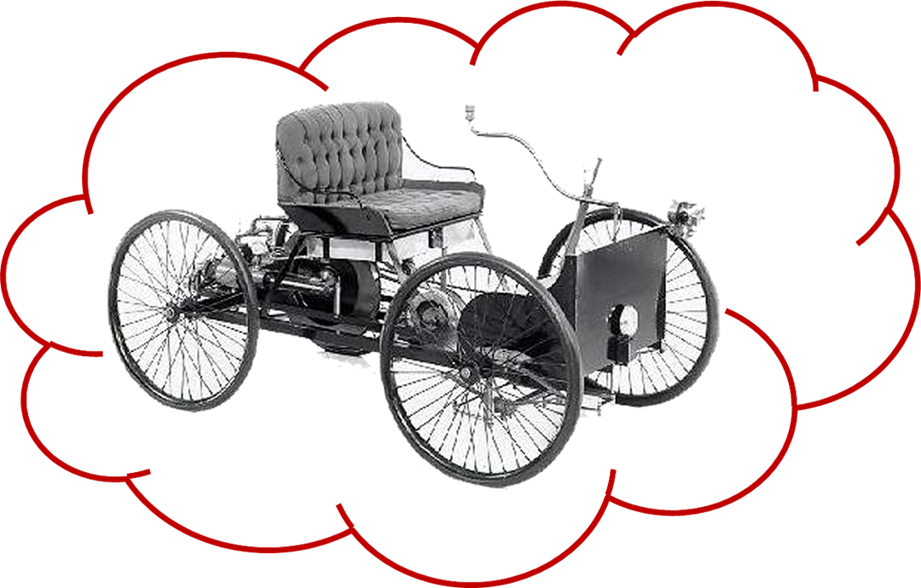


departments
A
B
C
D
Notes:
Didactically presenting the problem making an analogy with building cars
The business starts as a little factory building rudimentary planes → the simple algorithm
ANALOGY
Factory  Language
Problem: Transportation  CSP
Product (solution): Cars  Solvers

Slide 7

The problem
TRANSPORTATION
Notes:
Didactically presenting the problem making an analogy with building cars
The business starts as a little factory building rudimentary planes → the simple algorithm
ANALOGY
Factory  Language
Problem: Transportation  CSP
Product (solution): Cars  Solvers

Slide 8
The problem
TRANSPORTATION
CSP
Notes:
Didactically presenting the problem making an analogy with building cars
The business starts as a little factory building rudimentary planes → the simple algorithm
ANALOGY
Factory  Language
Problem: Transportation  CSP
Product (solution): Cars  Solvers

Slide 9
The problem
TRANSPORTATION
CSP
The tool
FACTORY
Notes:
Didactically presenting the problem making an analogy with building cars
The business starts as a little factory building rudimentary planes → the simple algorithm
ANALOGY
Factory  Language
Problem: Transportation  CSP
Product (solution): Cars  Solvers

Slide 10
The problem
TRANSPORTATION
CSP
The tool
FACTORY
POSL
Notes:
Didactically presenting the problem making an analogy with building cars
The business starts as a little factory building rudimentary planes → the simple algorithm
ANALOGY
Factory  Language
Problem: Transportation  CSP
Product (solution): Cars  Solvers

Slide 11
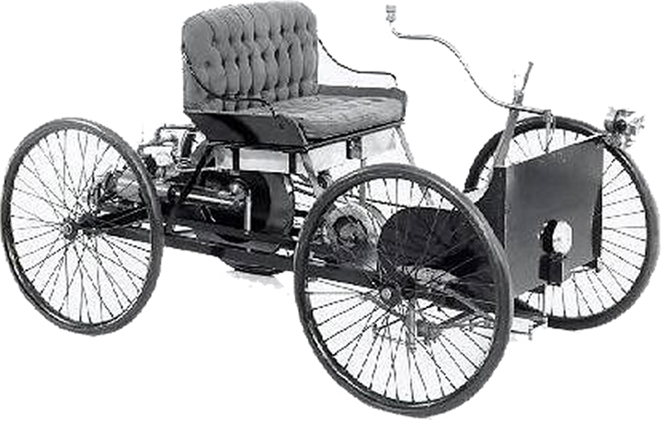
The problem
TRANSPORTATION
CSP
The tool
FACTORY
POSL
The product
CARS
Notes:
Didactically presenting the problem making an analogy with building cars
The business starts as a little factory building rudimentary planes → the simple algorithm
ANALOGY
Factory  Language
Problem: Transportation  CSP
Product (solution): Cars  Solvers

Slide 12
The problem
TRANSPORTATION
CSP
The tool
FACTORY
POSL
The product
CARS
SOLVERS
Notes:
Didactically presenting the problem making an analogy with building cars
The business starts as a little factory building rudimentary planes → the simple algorithm
ANALOGY
Factory  Language
Problem: Transportation  CSP
Product (solution): Cars  Solvers

Slide 13
The problem
TRANSPORTATION
CSP
The tool
FACTORY
POSL
The product
CARS
SOLVERS
Notes:
Didactically presenting the problem making an analogy with building cars
The business starts as a little factory building rudimentary planes → the simple algorithm
ANALOGY
Factory  Language
Problem: Transportation  CSP
Product (solution): Cars  Solvers

Slide 14
1
2
BUSINESS GROWTH
TWO ALTERNATIVES
departments
A
B
C
D
Notes:
The business needs to grow, so two alternatives:
1-Building a bigger factory  Creating an algorithm allowing to solve more complex instances (sequential approach)
2-Building more little factories (franchises)  The same algorithm using more computation resources (parallel approach)

Slide 15
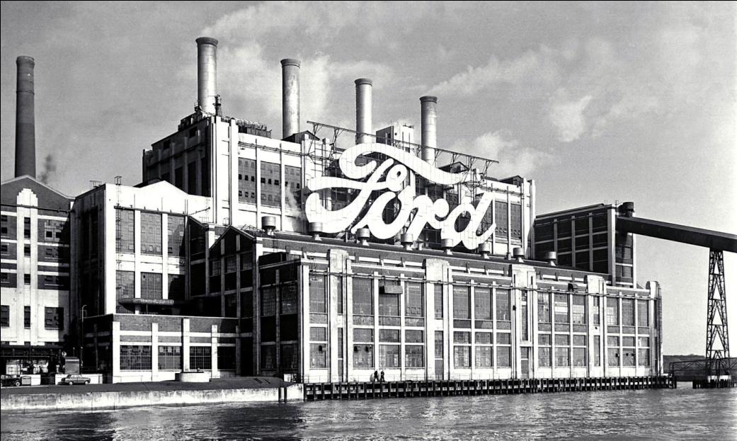
1
2
BUSINESS GROWTH
TWO ALTERNATIVES
departments
A
A
B
B
A
A
B
B
C
C
D
D
C
C
D
D
ALGORITHMS
allowing to solve
more
COMPLEX INSTANCES
OF
CSP
Notes:
The business needs to grow, so two alternatives:
1-Building a bigger factory  Creating an algorithm allowing to solve more complex instances (sequential approach)
2-Building more little factories (franchises)  The same algorithm using more computation resources (parallel approach)

Slide 16
1
2
BUSINESS GROWTH
TWO ALTERNATIVES
departments
A
A
B
B
A
A
B
B
C
C
D
D
C
C
D
D
SEQUENTIAL
APPROACH
Notes:
The business needs to grow, so two alternatives:
1-Building a bigger factory  Creating an algorithm allowing to solve more complex instances (sequential approach)
2-Building more little factories (franchises)  The same algorithm using more computation resources (parallel approach)

Slide 17
2
2
BUSINESS GROWTH
TWO ALTERNATIVES
A
B
A
B
C
D
C
D
A
B
A
B
C
D
C
D
the same
ALGORITHM
using
MORE
computational
RESOURCES
Notes:
The business needs to grow, so two alternatives:
1-Building a bigger factory  Creating an algorithm allowing to solve more complex instances (sequential approach)
2-Building more little factories (franchises)  The same algorithm using more computation resources (parallel approach)

Slide 18
2
2
BUSINESS GROWTH
TWO ALTERNATIVES
A
B
A
B
C
D
C
D
A
B
A
B
C
D
C
D
PARALLEL
APPROACH
Notes:
The business needs to grow, so two alternatives:
1-Building a bigger factory  Creating an algorithm allowing to solve more complex instances (sequential approach)
2-Building more little factories (franchises)  The same algorithm using more computation resources (parallel approach)

Slide 19

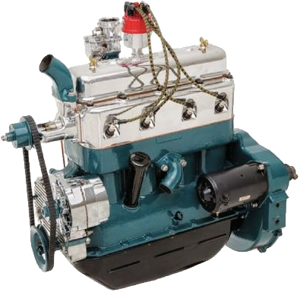
?
NEW
VERSION
best
case
only
ONE
change
A
B
C
D
Notes:
Time + competitors = new version !
The step towards a new version can be (in the best case) changing something in one of the departments (pneumatics, for example)
It implies changing this department in every little factory.
FISRT GOAL of POSL:
It propose creating little factories specialized on a specific part of the car, and then an assembly plant to join them.

Slide 20
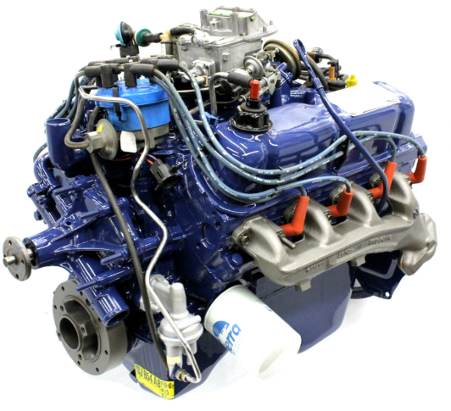
?
NEW
VERSION
best
case
only
ONE
change
A
B
C
D
Notes:
Time + competitors = new version !
The step towards a new version can be (in the best case) changing something in one of the departments (pneumatics, for example)
It implies changing this department in every little factory.
FISRT GOAL of POSL:
It propose creating little factories specialized on a specific part of the car, and then an assembly plant to join them.

Slide 21
?
NEW
VERSION
best
case
only
ONE
change
A
A
B
B
C
D
C
D
A
A
B
B
C
D
C
D
Notes:
Time + competitors = new version !
The step towards a new version can be (in the best case) changing something in one of the departments (pneumatics, for example)
It implies changing this department in every little factory.
FISRT GOAL of POSL:
It propose creating little factories specialized on a specific part of the car, and then an assembly plant to join them.

Slide 22


FERST
GOAL
OF
POSL
CREATING
SPECIALIZED
LITTLE
FACTORIES
AND THEN
ASSEMBLY PLANTS
TO JOIN PARTS
Notes:
Time + competitors = new version !
The step towards a new version can be (in the best case) changing something in one of the departments (pneumatics, for example)
It implies changing this department in every little factory.
FISRT GOAL of POSL:
It propose creating little factories specialized on a specific part of the car, and then an assembly plant to join them.

Slide 23
FERST
GOAL
OF
POSL
CREATING
SPECIALIZED
LITTLE
FACTORIES
AND THEN
ASSEMBLY PLANTS
TO JOIN PARTS
Notes:
Time + competitors = new version !
The step towards a new version can be (in the best case) changing something in one of the departments (pneumatics, for example)
It implies changing this department in every little factory.
FISRT GOAL of POSL:
It propose creating little factories specialized on a specific part of the car, and then an assembly plant to join them.

Slide 24
FERST
GOAL
OF
POSL
A
A
B
B
C
D
C
D
A
A
B
B
C
D
C
D
Notes:
Time + competitors = new version !
The step towards a new version can be (in the best case) changing something in one of the departments (pneumatics, for example)
It implies changing this department in every little factory.
FISRT GOAL of POSL:
It propose creating little factories specialized on a specific part of the car, and then an assembly plant to join them.

Slide 25
FERST
GOAL
OF
POSL
A
A
A
A
B
B
C
D
C
D
B
B
C
D
C
D
Notes:
Time + competitors = new version !
The step towards a new version can be (in the best case) changing something in one of the departments (pneumatics, for example)
It implies changing this department in every little factory.
FISRT GOAL of POSL:
It propose creating little factories specialized on a specific part of the car, and then an assembly plant to join them.

Slide 26
FERST
GOAL
OF
POSL
A
A
A
A
B
B
C
C
D
D
C
C
B
B
D
D
Notes:
Time + competitors = new version !
The step towards a new version can be (in the best case) changing something in one of the departments (pneumatics, for example)
It implies changing this department in every little factory.
FISRT GOAL of POSL:
It propose creating little factories specialized on a specific part of the car, and then an assembly plant to join them.

Slide 27
FERST
GOAL
OF
POSL
A
A
B
B
A
A
B
B
C
C
D
D
C
C
D
D
Notes:
Time + competitors = new version !
The step towards a new version can be (in the best case) changing something in one of the departments (pneumatics, for example)
It implies changing this department in every little factory.
FISRT GOAL of POSL:
It propose creating little factories specialized on a specific part of the car, and then an assembly plant to join them.

Slide 28
FERST
GOAL
OF
POSL
A
A
B
B
A
A
B
B
C
C
D
D
C
C
D
D
Notes:
Time + competitors = new version !
The step towards a new version can be (in the best case) changing something in one of the departments (pneumatics, for example)
It implies changing this department in every little factory.
FISRT GOAL of POSL:
It propose creating little factories specialized on a specific part of the car, and then an assembly plant to join them.

Slide 29
POSL presentation
Presenting each stage of the building process using POSL, still making the analogy with cars:
MODULES
Operation modules
Little factories building specifics pieces (using rubber as input, create pneumatics as output) ↔ simple functions (using a vector as input it returns a set of vectors)
Communication modules
Storage facilities to receive pieces from other factories ↔ functions able to receive information (vectors, set of vectors)

Slide 30
POSL presentation
OPERATORS
Assembly plants ↔ joining the modules (examples)
Abstract solver concept
Imagine mobile assembly plants: they are created to receive different types of generic (not specific) pieces and assembly them ↔ Operators are used not using concrete modules, but abstract modules, characterized only by their signatures (examples, code and advantages)
Introducing directly the stage of instantiating solvers (examples and code)

Slide 31
POSL presentation
THE MAIN ADVANTAGE OF POSL: Communication
A simple language to create communication strategies, capable to define/express:
What to communicate: There exists different types of communication modules, able to receive any kind of information
Where to communicate: They can be combined with other modules using operators
When to communicate: Abstract solvers can be configured using simple Boolean expressions together with operator to indicate code bifurcations
How to communicate: Different connection topologies can be created using communication operators
(examples and code)

Slide 32
POSL presentation
Summarizing the characteristics of POSL

Slide 33
Communication strategies study
Second Goal of the presentation
Presenting a study of different communication strategies applied to some classical constraint satisfaction problems
Presenting each problem

Slide 34
Parallel without communication
Presenting abstract solvers for each problem
Explaining some characteristic (reset for Costas, tabu for Golomb, etc.)
Presenting results

Slide 35
Simple communication
Presenting abstract solvers for each problem
Explaining some characteristic (variant A and B for Costas, etc.)
Presenting results

Slide 36
Local minimum evasion
Presenting the abstract solver for Golomb Ruler
Explaining why this strategy for it.
Presenting results

Slide 37
Standard – Companion strategy
Presenting abstract solvers for each problem
Explaining some characteristic (modules of companion solvers)
Presenting results

Slide 38
Communication strategies study
Conclusions of the study

Slide 39
Conclusions and future works

Slide 40
Introduction
P.O.S.L.
parallel
oriented
solver
language
System of interconnected meta-heuristic-based solvers
working in parallel
To solve CSP

Slide 41

Introduction
Main goal of this presentation
Introducing
P.O.S.L.
parallel
oriented
solver
language
Show some of its main advantages
many different solvers
many different cooperation strategies

Slide 42
Introduction
Contraint Satisfaction Problems
Notes:
Je crois pas nécessaire expliquer c’est quoi un problème de satisfaction de contraintes, c’est pour ça que je vais pas m’arrêter sur cette diapositive la.

Slide 43
Building parallel solvers with POSL
4 Stages
Creating modules
Joining modules
Creating solvers
Connecting solvers
Computation modules
Communication modules
Notes:
Maintenant je vous explique comment construire des solveurs avec POSL.
POSL permet de construire des solveurs suivant 4 étapes :
1- Créer les modules de POSL. Modules de calcul (operation module) et modules d’échange d’information Je passe maintenant à vous expliquer cette étape.

Slide 44
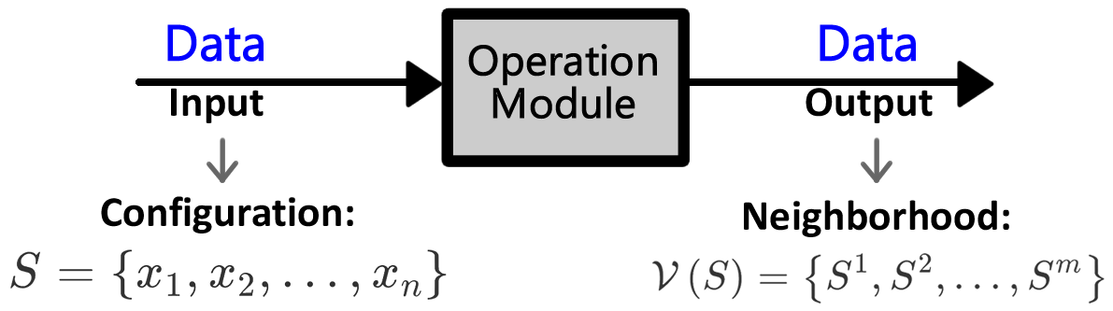
1- Creating modules
Computation modules
Notes:
Un operation module est une fonction qui reçoit une entrée, puis il exécute un algorithme interne et renvoie une sortie.
Dans la figure, un EXEMPLE d’operation module qui reçoit une configuration puis calcule son voisinage

Slide 45
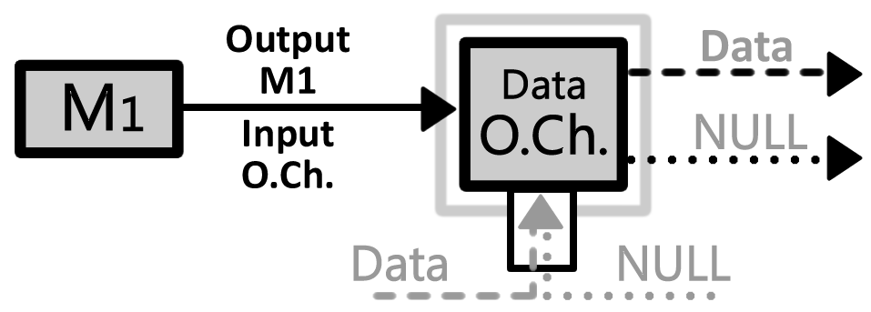
1- Creating modules
Computation modules
Communication modules
Notes:
A module de communication est aussi une fonction mais qui reçoit aussi des informations provenant de l’exterieur (c.a.d. d’autre solveur)

Slide 46
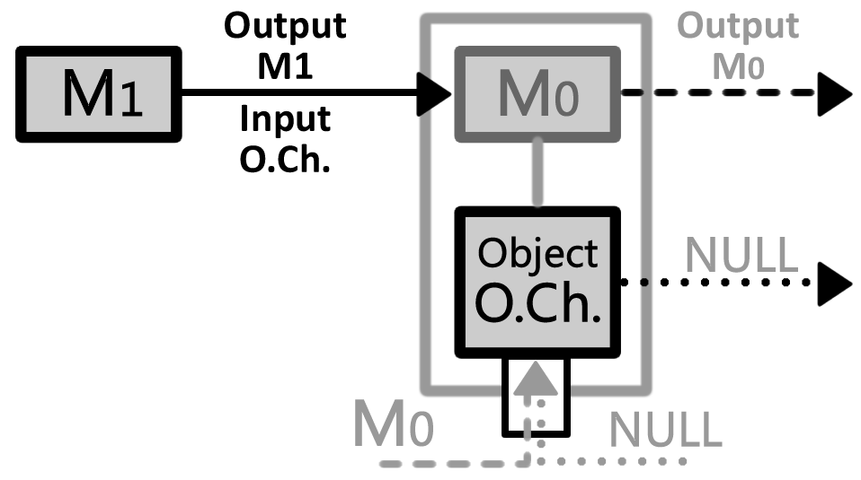
1- Créer les modules
Modules de calcul (operation modules)
Informations à recevoir (open channel)
Notes:
Maintenant je vous explique qu’est-ce que c’est un solveur POSL.
POSL permet de construire des solveurs suivant différentes étapes :
1- L’algorithme est exprimé via une décomposition en modules de calcul. Nous appelons operation module ces
morceaux de calcul
2- L’étape suivante consiste à décider quelles sont les types d’informations que l’on souhaite recevoir des autres solveurs. Ces informations sont
encapsulées dans des composants appelés open channel, permettant de transmettre des données entre solveurs

Slide 47
Building parallel solvers with POSL
4 Stages
Creating modules
Joining modules
Creating solvers
Connecting les solvers
A program joining computation modules and communication modules (abstract solver)

Slide 48

2- Joining modules
Joining computation and communication modules
Parametric operators
Notes:
Ici, dans l’exemple, c’est montré deux solveurs avec des comportements différents : L’operateur V renvoi la sortie de l’open channel si il à reçu quelque chose, ou la sortie du module M2 sinon

Slide 49

2- Joining modules
Sequential execution operator
Notes:
Ici, dans l’exemple, c’est montré deux solveurs avec des comportements différents : L’operateur V renvoi la sortie de l’open channel si il à reçu quelque chose, ou la sortie du module M2 sinon

Slide 50

2- Joining modules
Notes:
Ici, dans l’exemple, c’est montré deux solveurs avec des comportements différents : L’operateur V renvoi la sortie de l’open channel si il à reçu quelque chose, ou la sortie du module M2 sinon

Slide 51

2- Joining modules
Notes:
Ici, dans l’exemple, c’est montré deux solveurs avec des comportements différents : L’operateur V renvoi la sortie de l’open channel si il à reçu quelque chose, ou la sortie du module M2 sinon

Slide 52

2- Joining modules
Cyclic execution operator
Notes:
Ici, dans l’exemple, c’est montré deux solveurs avec des comportements différents : L’operateur V renvoi la sortie de l’open channel si il à reçu quelque chose, ou la sortie du module M2 sinon

Slide 53
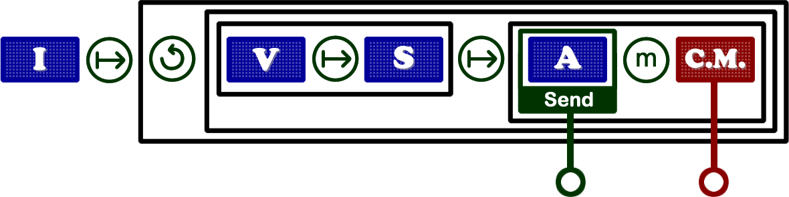
2- Joining modules
Sending output operator
Minimum output operator
Notes:
Ici, dans l’exemple, c’est montré deux solveurs avec des comportements différents : L’operateur V renvoi la sortie de l’open channel si il à reçu quelque chose, ou la sortie du module M2 sinon

Slide 54
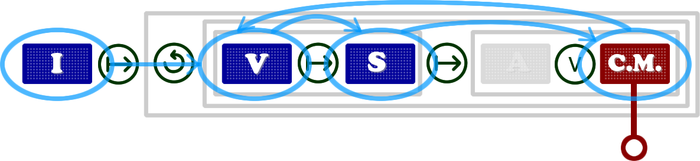

2- Joining modules
Not null operator
Notes:
Ici, dans l’exemple, c’est montré deux solveurs avec des comportements différents : L’operateur V renvoi la sortie de l’open channel si il à reçu quelque chose, ou la sortie du module M2 sinon

Slide 55
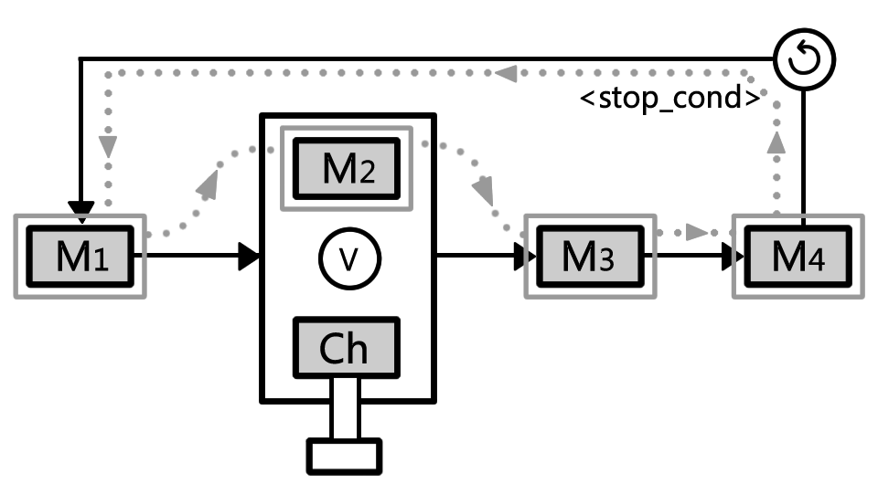
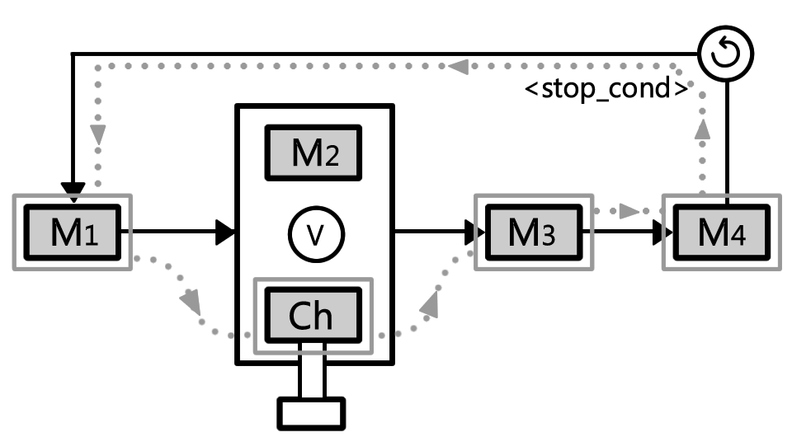
2- Joining modules
Joining computation and communication modules
Parametric operatos
Notes:
Ici, dans l’exemple, c’est montré deux solveurs avec des comportements différents : L’operateur V renvoi la sortie de l’open channel si il à reçu quelque chose, ou la sortie du module M2 sinon

Slide 56
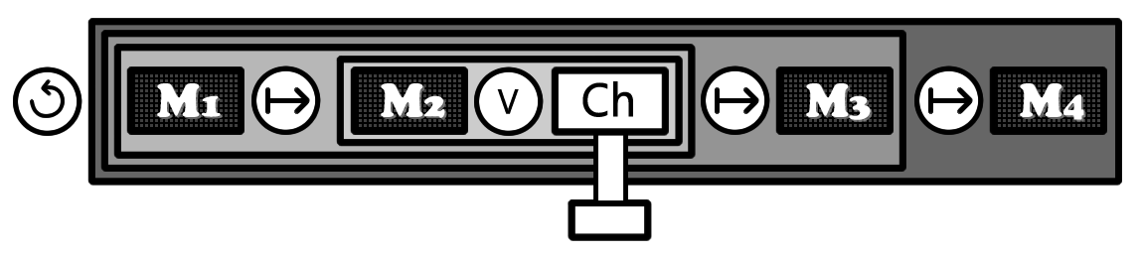
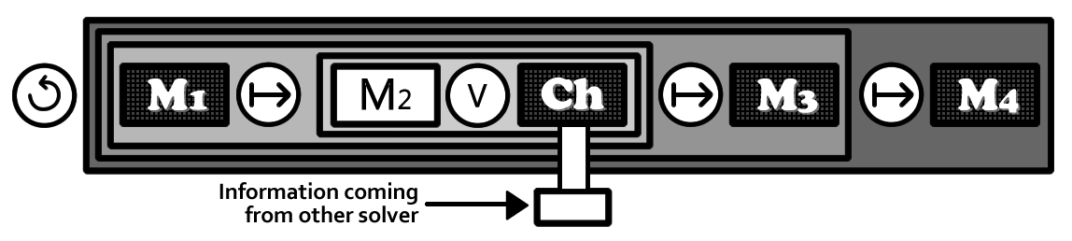
2- Assembler les modules
Joindre operation modules et open channels
Décider informations à envoyer
Opérateurs paramétriques

Slide 57
2- Assembler les modules
while (<stop_cond>)
execute(
execute(execute(M1, or(M2, Ch)), M3),
M4
)
end

Slide 58

2- Assembler les modules
while (<stop_cond>)
execute(
execute(execute(M1, or(M2, Ch)), M3),
M4
)
end

Slide 59
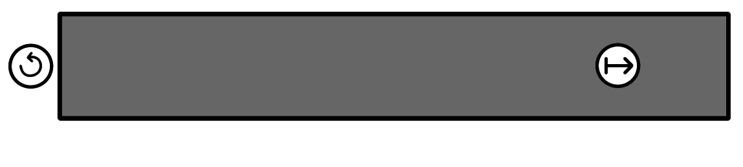
2- Assembler les modules
while (<stop_cond>)
execute(
execute(execute(M1, or(M2, Ch)), M3),
M4
)
end

Slide 60
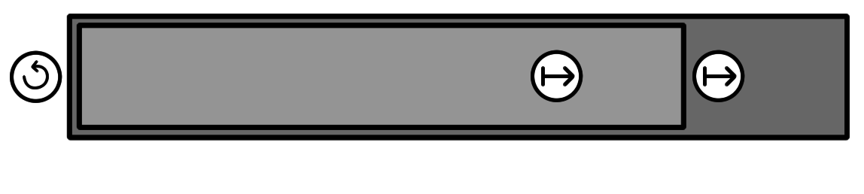
2- Assembler les modules
while (<stop_cond>)
execute(
execute(execute(M1, or(M2, Ch)), M3),
M4
)
end

Slide 61
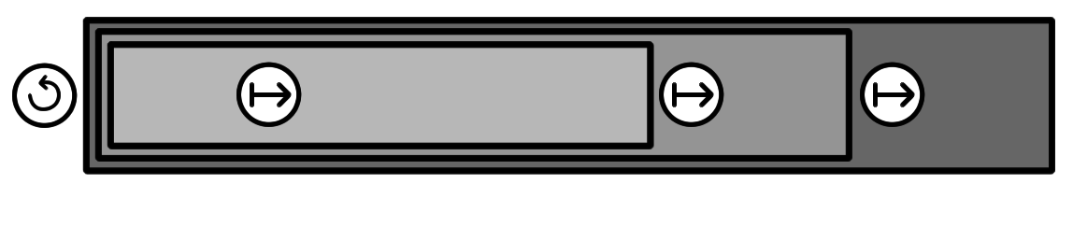
2- Assembler les modules
while (<stop_cond>)
execute(
execute(execute(M1, or(M2, Ch)), M3),
M4
)
end

Slide 62
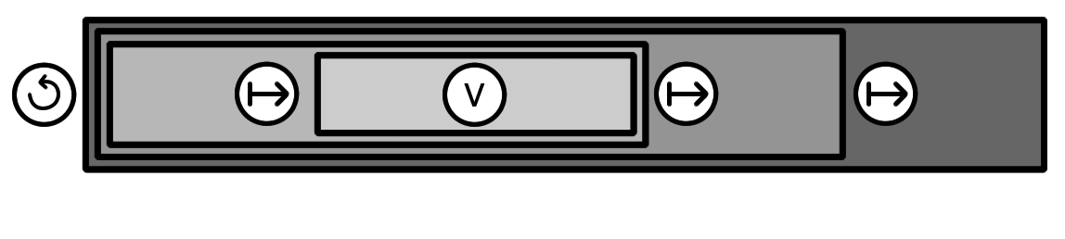
2- Assembler les modules
while (<stop_cond>)
execute(
execute(execute(M1, or(M2, Ch)), M3),
M4
)
end

Slide 63
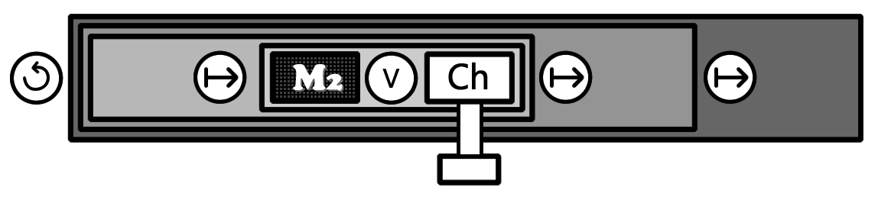
2- Assembler les modules
while (<stop_cond>)
execute(
execute(execute(M1, or(M2, Ch)), M3),
M4
)
end

Slide 64
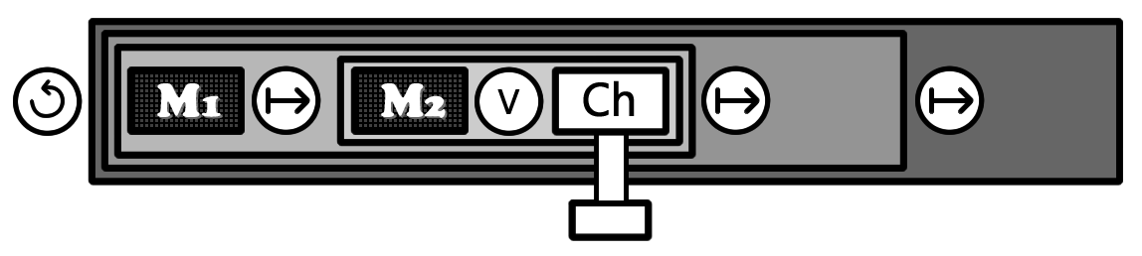
2- Assembler les modules
while (<stop_cond>)
execute(
execute(execute(M1, or(M2, Ch)), M3),
M4
)
end

Slide 65
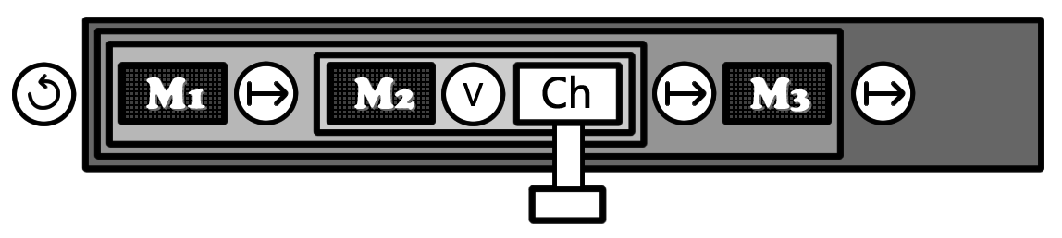
2- Assembler les modules
while (<stop_cond>)
execute(
execute(execute(M1, or(M2, Ch)), M3),
M4
)
end

Slide 66

2- Assembler les modules
while (<stop_cond>)
execute(
execute(execute(M1, or(M2, Ch)), M3),
M4
)
end

Slide 67
Building parallel solvers with POSL
4 Stages
Creating modules
Joining modules
Creating solvers
Connecting solvers
Instantiating computation and communication modules into the abstract solver

Slide 68
3- Creating solvers
… by instantiating declared modules:
St := abstract solver
computation : I, V, S, A;
communication : C.M.;
{
execute(I, while (<stop_cond>)
execute(execute(V, S), min(A, C.M.))
end
)
}

Slide 69
3- Creating solvers
… by instantiating declared modules:
St := abstract solver
computation : I, V, S, A;
communication : C.M.;
{
execute(I, while (<stop_cond>)
execute(execute(V, S), min(A, C.M.))
end
)
}
Sk := solver {
abstract solver : St;
computation : OM.Rand, OM.1Swap, OM.BI, OM.AI;
communication : OCh.Last;
}

Slide 70
Building parallel solvers with POSL
4 Stages
Creating modules
Joining modules
Creating solvers
Connecting solvers
Creating communication channels (communication strategy)
Notes:
4-eme étape : Créer les canaux de communication → connecter les solveurs entre eux. Ce qu’on appelle une méta-strategy

Slide 71
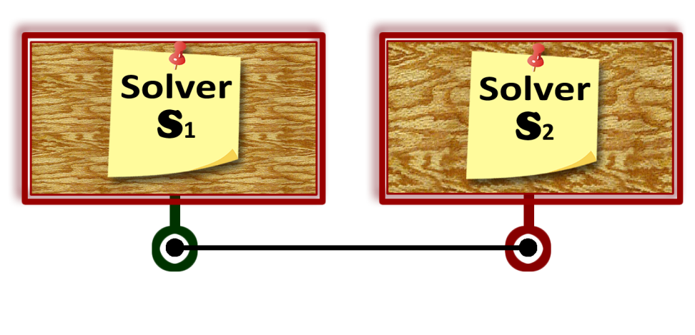
4- Connecting solvers
Connected solvers
The connection can be defined
if and only if:
S₁ has a computation module Mv
The output of Mv has been sent
S1 . Mv
Op
S2 . Ch₂

Slide 72
4- Connecting solvers
Connected solvers
The connection can be defined
if and only if:
S₂ has a communication module Ch₂
Ch₂ receives the same type of information sent by Mv
S1 . Mv
Op
S2 . Ch₂

Slide 73
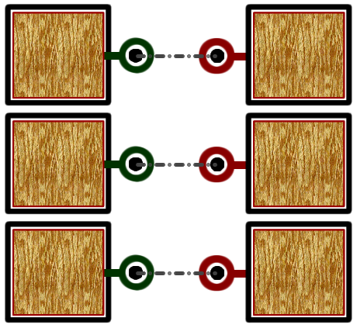
4- Connecting solvers
[solver_1.s1, solver_2.s2, ... solver_k.sn]
-->
[solver_1.ch1, solver_2.ch2, ... solver_k.chn];

Slide 74
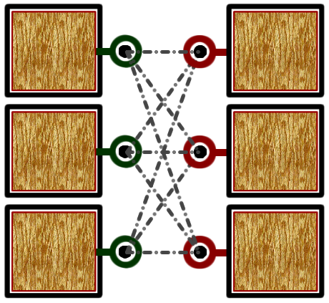
4- Connecting solvers
[solver_1.s1, solver_2.s2, ... solver_k.sn]
#->
[solver_1.ch1, solver_2.ch2, ... solver_k.chm];

Slide 75
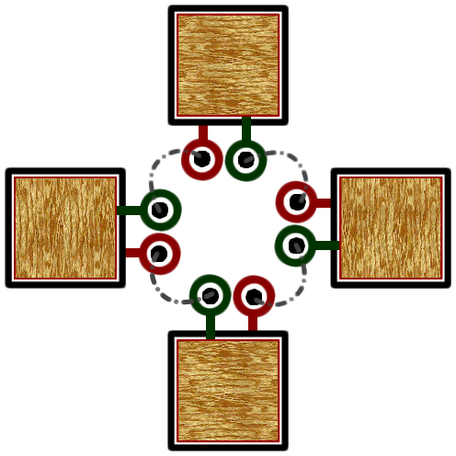
4- Connecting solvers
[solver_1.s1, solver_2.s2, ... solver_k.sn]
<>
[solver_1.ch1, solver_2.ch2, ... solver_k.chn];

Slide 76
Experiments design
Target problems
Costas Array
Social Golfers
N-Queens
Golomb-Ruler

Slide 77
Experiments design
Target problems
Costas Array
Social Golfers
N-Queens
Golomb-Ruler
Placing n marks on a matrix (grid) of n × n :
Exactly one mark per row and per column,
Vectors joining each couple of marks must be all differents.

Slide 78

Costas Array
I
Initial random configuration
V
Neighborhood of a given configuration
S
New configuration Selection criterion
A
New configuration Acceptance criterion

Slide 79
Costas Array
I
Initial random configuration
V
Neighborhood of a given configuration
S
New configuration Selection criterion
A
New configuration Acceptance criterion

Slide 80
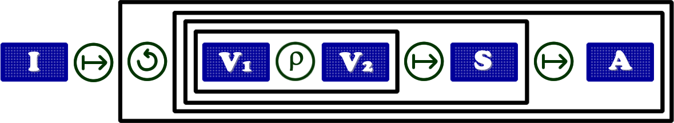
Costas Array
I
Initial random configuration
V
Neighborhood of a given configuration
S
New configuration Selection criterion
A
New configuration Acceptance criterion

Slide 81
Costas Array
I
Initial random configuration
V
Neighborhood of a given configuration
S
New configuration Selection criterion
A
New configuration Acceptance criterion

Slide 82
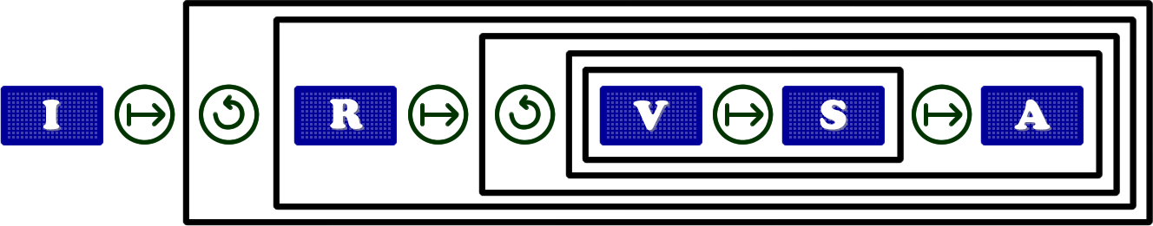
Costas Array
I
Initial random configuration
R
Reset
V
Neighborhood of a given configuration
S
New configuration Selection criterion
A
New configuration Acceptance criterion

Slide 83
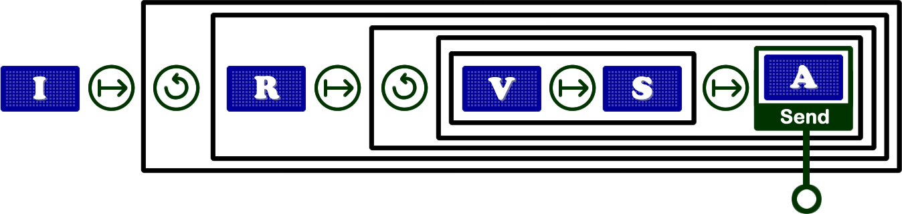
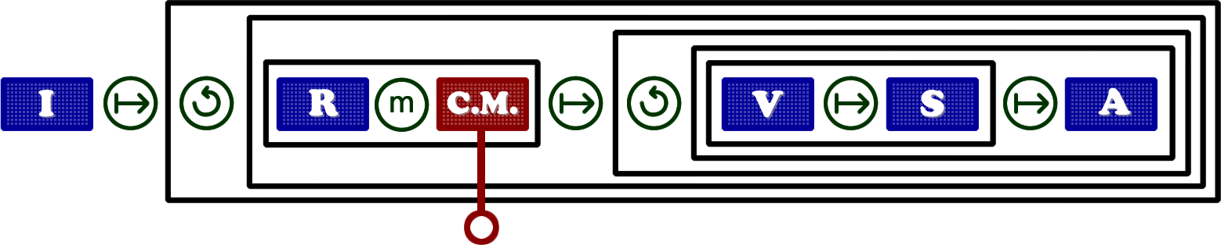

Costas Array
Communication
Op
C.M.
Receiving a configuration
Op
-- > : 1 to 1
#-> : 1 to N

Slide 84
Costas Array
Communication
Op
C.M.
Receiving a configuration
Op
-- > : 1 to 1
#-> : 1 to N

Slide 85
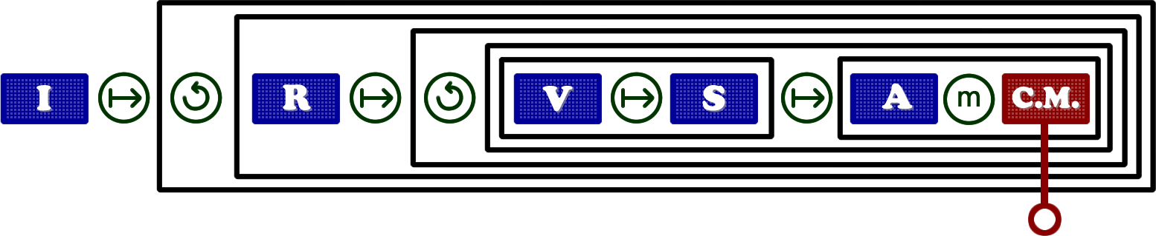
Costas Array
Communication
Op
C.M.
Receiving a configuration
Op
-- > : 1 to 1
#-> : 1 to N

Slide 86
Costas Array
Results (Costas Array)
Strategy | Time | Iterations | % success
Sequential | 2.12 | 44,453 | 42.0
Parallel (no communication) | 0.73 | 9,555 | 100
Parallel with cooperation | 0.41 | 4,973 | 100
Costas Array 17

Slide 87
Conclusions
P.O.S.L.
parallel
oriented
solver
language
Possibility of implementing many different
communication strategies
(First results)
Communication an important role
Easy and Fast the study and implementation

Slide 88
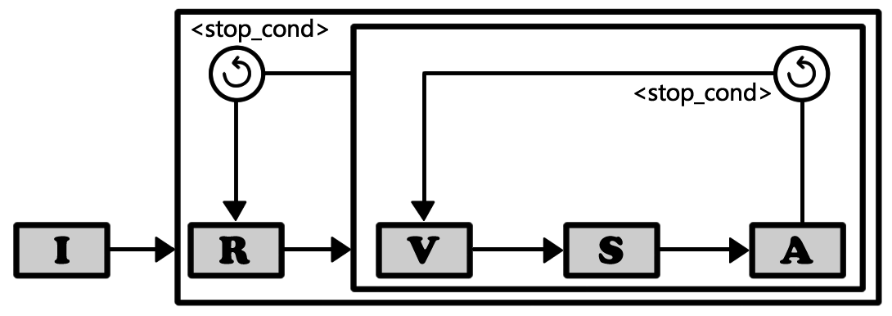
Costas Array
I
Génération de configuration Initiale
R
Reset
V
Calcul du Voisinage
S
Sélection de la nouvelle configuration
A
Critère d’Acceptation de la nouvelle configuration

Slide 89
Expérimentation
Problèmes cibles
Social Golfers
Costas Array
Planifier n = g × p golfeurs
g groupes, p joueurs
chaque semaine pendant w semaines :
Deux joueurs jouent dans le même groupe au plus UNE fois.

Slide 90
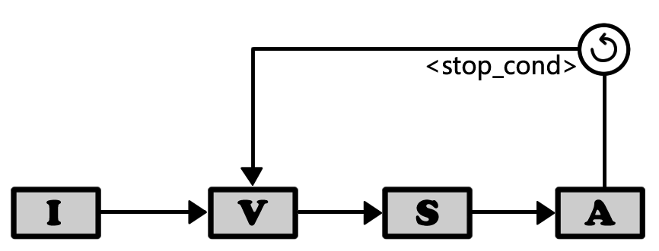
Social Golfers
I
Génération de configuration Initiale
V
Calcul du Voisinage
S
Sélection de la nouvelle configuration
A
Critère d’Acceptation de la nouvelle configuration

Slide 91
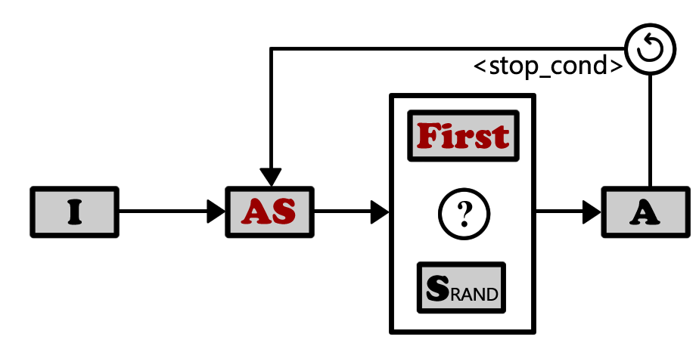
Social Golfers
AS
Permutation du meilleur candidat
First
Première-meilleure configuration
SRAND
Configuration aléatoire
?
Exécution conditionnelle

Slide 92
Social Golfers
Expérience No. 1 Sélection du module de calcul du voisinage

Slide 93
Social Golfers
Expérience No. 1 Sélection du module de calcul du voisinage
V
Permutation entre les joueurs (STD)
V
Permutation du joueur avec le plus grand coût projeté (AS)

Slide 94
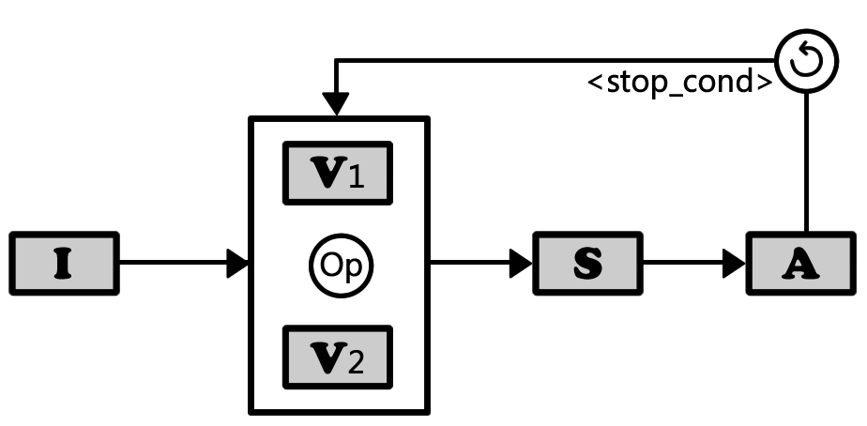
Social Golfers
Expérience No. 1 Sélection du module de calcul du voisinage
V1
Permutation entre les joueurs (STD)
V2
Permutation du joueur avec le plus grand coût projeté (AS)
Op
U
ρ
Union
Probabilité

Slide 95
Social Golfers
Expérience No. 1 Sélection du module de calcul du voisinage
Stratégie | Temps | Iterations
AS | 1.06 | 352
AS ρ STD | 41.53 | 147
AS U STD | 59.65 | 198
STD | 87.90 | 146
Social Golfers 10-10-3
Remarques
Stratégie : pas plus de 3 semaines
AS : Adaptive Search → très bons résultats
AS : plus rapide et plus d’itérations ??

Slide 96
Social Golfers
Expérience No. 2 Sélection du module de sélection

Slide 97
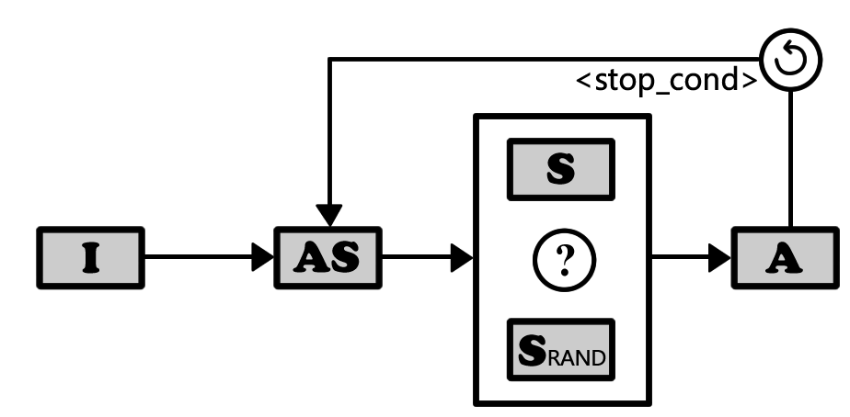
Social Golfers
Expérience No. 2 Sélection du module de sélection
S
Meilleure configuration (Best)
SRAND
Configuration aléatoire
?
Exécution conditionnelle

Slide 98
Social Golfers
Expérience No. 2
Expérience No. 2 Sélection du module de sélection
S
Première-meilleure configuration (First)
SRAND
Configuration aléatoire
?
Exécution conditionnelle

Slide 99
Social Golfers
Expérience No. 2 Sélection du module de sélection
Instance | Best |  | First
 | Temps | Iterations | Temps | Iterations
5 – 3 – 7 | 4.99 | 4,421 | 1.32 | 1,322
8 – 4 – 7 | 5.10 | 954 | 1.82 | 445
8 – 4 – 8 | 12.37 | 1,342 | 6.43 | 873
11 – 7 – 5 | 5.19 | 251 | 2.22 | 273
Remarques
Social Golfers 10-10-3
Best : lente car tombe sur des minimums locaux
First : moins intensifiant, mais plus rapide et diversifiant
Stratégie exploratoire : bonne pour Social Golfers

Slide 100
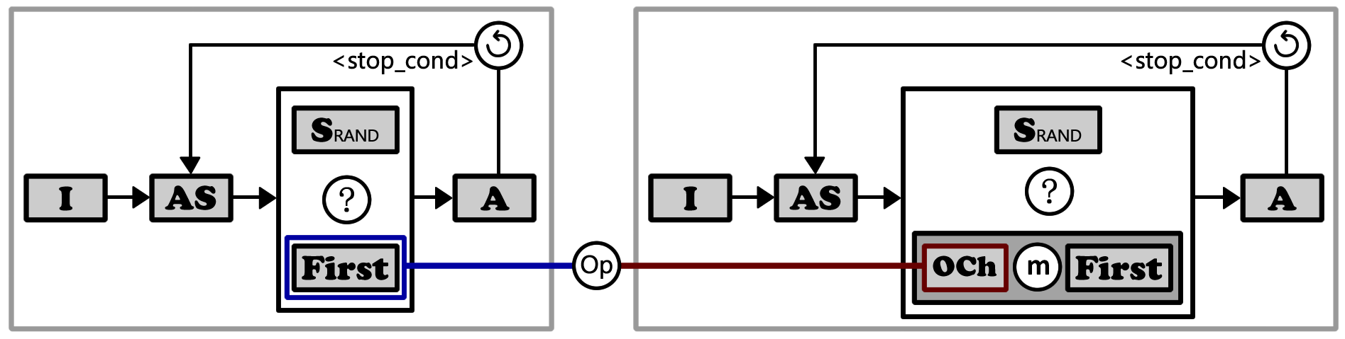
Social Golfers
Etude de la communication
OCh
Recevoir une structure de décision
Op
-->
1 à 1
#->
1 à N
Notes:
Pour l’etude de la communication on utilise une stratégie multiwalk
Ou touts les solveurs vont resoudre le meme probleme
Et la solution final c’est la solution du solver qui a fini en premier

Slide 101
Social Golfers
Etude de la communication
Instance | Sans Com. |  | Avec Com. (Meilleur) |  | Avec Com. (Pire)
 | Temps | It. | Temps | It. | Temps | It.
5 – 3 – 7 | 1.32 | 1,322 | 0.90 | 881 | 1.19 | 1,156
8 – 4 – 7 | 1.82 | 445 | 1.30 | 317 | 1.46 | 352
9 – 4 – 8 | 6.43 | 873 | 4.33 | 599 | 5.51 | 736
11 – 7 – 5 | 2.22 | 273 | 1.62 | 202 | 1.99 | 242
Communication 100%, 50% et 25%. Opérateurs 1-1 et 1-N. 40 cœurs
Notes:
Dans ces tableaux nous montrons un résumé de tout les test qu’on nous avons fait. Pour chaque instance nous avons fait 30 runs sans communication et avec communication en combinant des pourcentages de solveurs communicants et les operateurs 1-1 et 1-N, et nous représentons les meilleurs et les pires résultats; pour montres que dans tout les cas la communication apporte un gain significatif

Slide 102
Social Golfers
Etude de la communication
Instance | Sans Com. |  | Avec Com. (Meilleur) |  | Avec Com. (Pire)
 | Temps | It. | Temps | It. | Temps | It.
5 – 3 – 7 | 1.32 | 1,322 | 0.90 | 881 | 1.19 | 1,156
8 – 4 – 7 | 1.82 | 445 | 1.30 | 317 | 1.46 | 352
9 – 4 – 8 | 6.43 | 873 | 4.33 | 599 | 5.51 | 736
11 – 7 – 5 | 2.22 | 273 | 1.62 | 202 | 1.99 | 242
Communication 100%, 50% et 25%. Opérateurs 1-1 et 1-N. 40 cœurs
Communication
Social Golfers 10-10-3
Certain gain
Pourcentage de solveurs récepteurs : haut
Notes:
Dans ces tableaux nous montrons un résumé de tout les test qu’on nous avons fait. Pour chaque instance nous avons fait 30 runs sans communication et avec communication en combinant des pourcentages de solveurs communicants et les operateurs 1-1 et 1-N, et nous représentons les meilleurs et les pires résultats; pour montres que dans tout les cas la communication

Slide 103
Expérimentation
Problèmes cibles
Social Golfers
Costas Array
Placer n marques dans une matrice (grille) de n × n :
Exactement une marque par ligne et par colonne,
Les vecteurs reliant chaque couple de marques doivent tous être différents.

Slide 104
Costas Array
I
Génération de configuration Initiale
R
Reset
V
Calcul du Voisinage
S
Sélection de la nouvelle configuration
A
Critère d’Acceptation de la nouvelle configuration

Slide 105
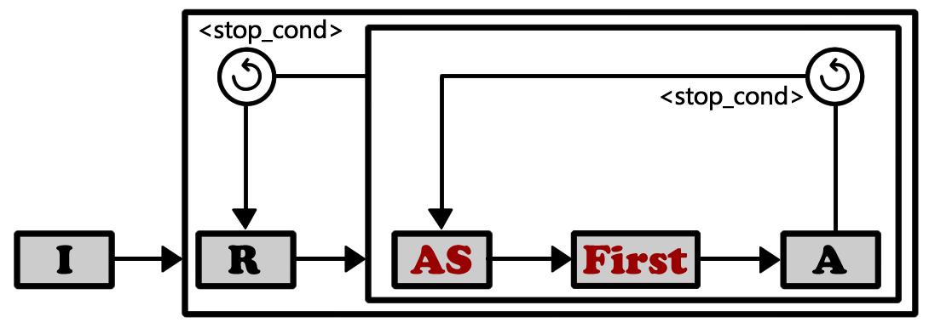
Costas Array
AS
Permutation du meilleur candidat
First
Première-meilleure configuration

Slide 106
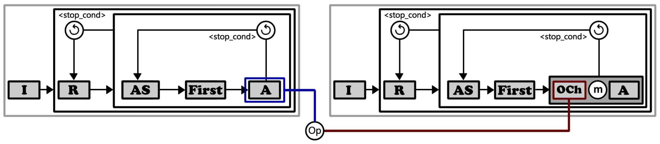
Costas Array
Etude de la communication (A)
OCh
Recevoir une configuration
Op
-->
1 à 1
#->
1 à N

Slide 107
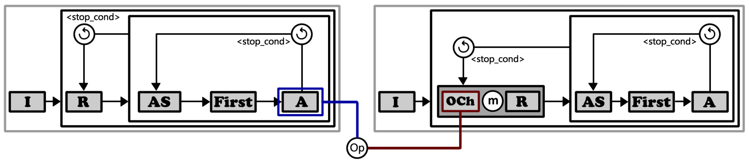
Costas Array
Etude de la communication (B)
OCh
Recevoir une configuration
Op
-->
1 à 1
#->
1 à N

Slide 108
Costas Array
Etude de la communication
Temps | Iterations | Cœurs | % réussi
2.24 | 35,299 | 1 | 48.5
1.44 | 24,041 | 20 | 100
Costas Array 17 (sans communication)
Stratégie A |  | Stratégie B |  | Type de Comm.
Temps | Iterations | Temps | Iterations
0.80 | 10,324 | 1.12 | 15,427 | 50% (1 à 1)
1.07 | 11,948 | 0.89 | 10,995 | 100% (1 à 1)
1.32 | 19,007 | 1.07 | 15,086 | 50% (1 à N)
1.34 | 17,473 | 1.04 | 12,847 | 100% (1 à N)
Costas Array 17 (avec communication, 20 cœurs)

Slide 109
Costas Array
Etude de la communication
Stratégie A |  | Stratégie B |  | Type de Comm.
Temps | Iterations | Temps | Iterations
0.80 | 10,324 | 1.12 | 15,427 | 50% (1 à 1)
1.07 | 11,948 | 0.89 | 10,995 | 100% (1 à 1)
1.32 | 19,007 | 1.07 | 15,086 | 50% (1 à N)
1.34 | 17,473 | 1.04 | 12,847 | 100% (1 à N)
Costas Array 17 (avec communication, 20 cœurs)

Slide 110
Costas Array
Etude de la communication
Stratégie A |  | Stratégie B |  | Type de Comm.
Temps | Iterations | Temps | Iterations
0.80 | 10,324 | 1.12 | 15,427 | 50% (1 à 1)
1.07 | 11,948 | 0.89 | 10,995 | 100% (1 à 1)
1.32 | 19,007 | 1.07 | 15,086 | 50% (1 à N)
1.34 | 17,473 | 1.04 | 12,847 | 100% (1 à N)
Communication
Social Golfers 10-10-3
Certain gain
Pourcentage de solveurs récepteurs : haut
A plus performante que B → Reset

Slide 111
Expérimentation
Problèmes cibles
Social Golfers
Costas Array
N-Queens
Placer n reines sur un échiquier :
Aucune d’entre elles peut frapper toutes les autres en un seul mouvement.

Slide 112
Conclusions
P.O.S.L.
parallel
oriented
solver
language
Possibilité d’implémenter différentes
stratégies de communication
PREMIERS RÉSULTATS
Communication joue un rôle essentiel
Facile et rapide implémenter et étudier

Slide 113
Travaux futurs
Enrichir le langage en proposant :
Des nouveaux operation modules
Des nouveaux operateurs : computation strategy
Améliorer le langage de définition du solveur
Elargir le langage des opérateurs de communication
Nouvelles stratégies de communication (type d’information a communiquer)

